Slide 1
Information Model / Tooling Integration
Recommendations
For Achieving Computable Interoperability with a
HL7/ISO “Common Logical Information Model (CLIM)”
CIMI Sponsored HL7 Investigative-Study, Task Force and
ONC, FHA, IPO DOD VA sponsored HIEA Technical Forum
Core Information Modeling SMEs
Report Out & JIF Proposal Foundation
September 18-23, 2016 HL7 Meeting
Presented by:
Nona Hall, BSN, MA
DoD/VA Interagency Program Office
On behalf of
DoD, VA & External Partner SMEs
See Notes Page
Notes:
CHRONOLOGY:
2008 Federal Health Information Models start
2011 Clinical Information Model Initiative (CIMI) start
2016-01-16 CIMI Sponsored HL7 Investigative Study start
The Jan-Sep 2016 CIMI-Sponsored HL7 CIMI-FHIM Integration Investigative-Study includes: The Open Group Healthcare Forum, HL7 CIMI WG, HL7 EHR WG and HL7 CIC WG
2016-03-01 CIMI-FHIM Integration Task Force
2016-08-15 “CIMI-FHIM-SOLOR-CQF Integration” Preliminary Report
2016-08-17/18 Health Interoperability and Exchange Alliance (HIEA) Technical Forum
Health Interoperability and Exchange Alliance (HIEA) Technical Forum
Topic: Information Modeling: Foundation to Semantic Interoperability
C0-Sponsors: ONC OST, FHA, IPO DOD VA
This Health Interoperability and Exchange Alliance (HIEA) Technical Forum on “Information Modeling: Foundation to Semantic Interoperability” event was a key component of a mix of collaborative activities. This event had key stakeholders coming together under the facilitation of the DoD/VA IPO ONC Liaison, Nona Hall, BSN, MA who on behalf of the co-sponsors and through the support of the IPO's HIEA Technical Forum showcased this initiative and results to date.
As we go forward, there is logic to stay connected no matter what current and immediate task we are attending to.
2016-09-07 FHA “CIMI-FHIM-SOLOR-CQF Integration” Report PPT-Brief to FHA Federal Partners
2016-09-15 “CIMI-FHIM-SOLOR-CQF Integration” Final Report
2016-09-17 through 23 HL7 Meeting in Baltimore, MD
“CIMI-FHIM-SOLOR-CQF Integration” Report PPT-Brief at HL7
HL7 FY2017 “CIMI-FHIM-SOLOR-CQF Integration” Project Scope Statement (PSS) vetted at HL7

Slide 2
Agenda
Information Modeling Efforts & Connection to FHIR
Current State
Problem
Objectives
Approach
Recommendations/Proposed Solution
Attributes of Success
Qs & As
FHIR contributions from Perspective of Modelers/Clinical Community
Advocate a clean separation of modeling semantics
Alignment of CIMI Reference Architypes and FHIR Core
Going Forward “Process Engagement Strategy”
Pilot Studies → model and tooling alignment
Ballot Process → US Realm FHIR profile and extension

Slide 3
Current State
Our goal is to help people live the healthiest lives possible” by enabling a “Learning Health System” supporting areas such as, but not limited to, Precision Medicine, Clinical Decision Support, Genomic/Omic Interoperability.
This requires data that is computable, usable, extensible, and interpretable across disparate systems - a state that currently does not exist
The solution proposed capitalizes on the inroads made with the exchange of data, standards and standards adoption, but brings back a focus on the data in order to make additional and necessary advancements
.
Notes:
The benefit of a standardized reusable modeling-foundation is computable-interoperability aka interpretability across time, locations, systems and care contexts, assuming the re-usable “stack” is standardized and has widespread implementation. This information-model “stack” foundation is mission-essential for
collection, communication, aggregation and interpretation of patient data to accelerate secondary uses in public health, disease surveillance, post-approval monitoring, and patient-centered outcomes research.
health-related services including telecare, clinical decision support, research, and quality measurement, improving healthcare access, quality, and uniformity.
patients, clinicians, and the public to realize major benefits from improved care coordination, reduction of medical errors, and decreased costs resulting in healthier lives.

Slide 4
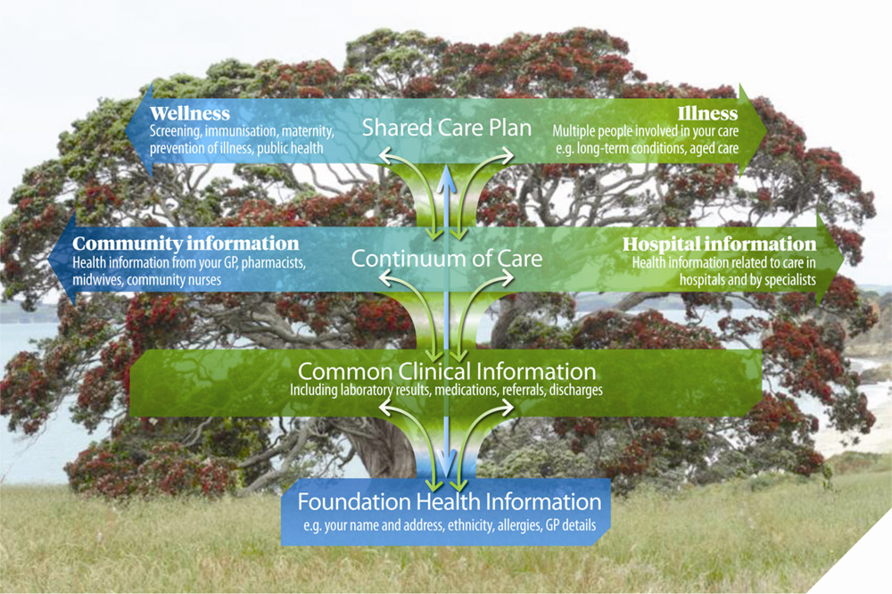
Clinical IT Requirements Shared Health Information Model
See Notes Page
Notes:
The tree metaphor of the IT solutions required to achieve an eHealth vision of sharing clinical knowledge. Interoperable data gets us part way to better care; clinical knowledge effectively integrated into systems and workflows is what can help us get to the optimized care we are all seeking to get to. An individual’s health information collected over time can be thought of as being like a ‘tree’. This ‘tree’ has levels which build on each other to provide a connected, health information story:
an individual’s foundation health information provides the ‘roots’
an effective and secure system for sharing information represents the ‘trunk’
common clinical information across the continuum of care represents the ‘branches’ of the tree.
aggregated, portable and computable patient-records, care plans, clinical knowledge and other shared healthcare information are the actionable leaves of the tree.
Following is the BLUF (Bottom Line Up Front).
The information modeling goal is to define compose-able common clinical knowledge in the form of healthcare information artifacts and terminology value sets, that can serve as the basis for patient-safe frictionless information-sharing, analytics and the creation of deterministic, compose-able, portable and computable patient-records, care plans, and other shared healthcare information.
The recommended solution is the coordinated integration and standardization of the harmonized CIMI-FHIM-SOLOR-CQF foundational healthcare information-model “stack” composed of a rich collection of re-usable information artifacts used to specify computable patient-health data-sets compose-able into higher level concepts, such as actionable patient-information.
Where possible, the information artifacts will refer to the evidence available in health care, e.g. based on scientific literature, specific guidelines or other sources.
These computable data-sets are for exchange, research, analytics and clinical decision support.
Each information model and each model’s data-set (e.g. FHIR) is defined with an unambiguous and computable meaning, employs a specific, shared vocabulary, has a specific information structure and is compose-able into higher-level concepts (aka actionable information).
We recommend analogous ISO and CIMI models be harmonized to ensure international consensus and interoperability.

Slide 5

Problem: Skyscraper Analogy
As-Is
To-Be
Not Harmonized
Not Harmonized
Harmonized
Shared Meaning
No shared terminology model or information model - not interoperable
No shared terminology model, shared information model - not interoperable
Shared terminology model and information model - interoperable future state
*Drawn from Dr. Keith Campbell’s analogy used within The Open Group Healthcare Forum (HCF) article:
Advancing Healthcare Interoperability www.opengroup.org/bookstore/catalog/w16a.htm
See Notes Page
Notes:
BLUF (Bottom Line Up Front)
As is: no shared terminology content (floor 1), no shared information models (floor 2), then they are building from the 3rd floor up. No shared value from the 3rd floor up.
Future State: shared terminology content (floor 1), shared information models (floor 2), sharable value built on floors above.
In a perfect world the following would be done concurrently and with close collaboration
Recommended Solution Part 1: We integrate SOLOR into FHIM
Concurrently, resolving SOLAR gaps
Recommended Solution Part 2: We integrate CIMI, FHIM and CQF
Recommended Solution Part 3: We follow Agile refinement cycles through pilots and implementations
Recommended Solution Part 3: We develop adequate documentation, test cases, fixtures and supporting resources
In the real world, we are asking:
the Federal Partners to provide resources to make efficient and effective progress in the near, mid and long term.
the Federal Partners to work together to deliver—in an ongoing way—a single integrated terminology system (SOLOR), that meets all US regulatory requirements, while simplifying implementation for developers.
the FHA to facilitate Federal Partner governance and configuration management of this work
This ONC OTS to endorse this initiative and facility resources
We are asking the IPO to provide coordination and facilitation
We are asking HL7 to facilitate
international, commercial and academic peer review and
ballot governance and configuration management.
Coordination of an ISO ballot (this will be several years from now)
Analogy of the Challenge: Today’s efforts occur as if we’re always trying to build the ultimate skyscraper, starting on the 3rd Floor.
Inconsistencies exist/become extended producing transformational (mapping) efforts = models, models everywhere
The problem is that today’s healthcare systems do not capture information and its context consistently, and consequently, they cannot easily share-or-merge information from different sources to create a computable operational-picture (aka longitudinal patient-records, care plans, clinical knowledge and other shared healthcare information across time, multiple care locations and differing contexts).
If continued and unchecked, even the best of implementation accelerators, like FHIR with its extensions and profiles, allow far too much implementation variation; where, each project often creates, from scratch, yet, another information model, e.g. through a mapping exercise.
The missed opportunity is to leverage a shared logical Reference Information Model minimizing the duplicative-work, avoiding inconsistencies and avoiding the necessity to engage these SMEs, these resources and our larger community. This is the “models, models everywhere phenomenon ”. As an example,
Standards, in general, use different formats and rules for ‘simple’ things like: name, address, dates. Resulting in EHR-systems that after decades cannot uniformly exchange this ‘simple’ ubiquitous data; let alone ‘complex’ clinical health data.
the HL7 EHR Interoperability workgroup, in its analysis “Record Entry Lifecycle Event Metadata using FHIR,” found substantial provenance (who, what, when, where and how) inconsistencies among FHIR resources .
http://wiki.hl7.org/index.php?title=EHR_Interoperability_WG
The SOLOR/LEGO team found FHIR tries to define things such as attributes for anatomy, that are not based on a particular model of anatomy, and thus you get semantic overlap, with the burden of reconciliation, which may not even be possible, if left to the end user.

Slide 6
Problem Statement
The problem is that today’s systems do not capture the same computable information in the same way. Consequently, we cannot easily share information or merge information from different sources to create a harmonized, operational picture of a patient across multiple care locations and contexts.
FHIR Core and DAF, currently embraced by the implementation community, are insufficient leading to unnecessary and extensive implementation variability.
See Notes Page
Notes:
Today, implementation is too complicated, and not interoperable, even when using well known standards.
FHIM exists to address one form of information modeling for the federal partners; less known to also serve a larger community, CIMI exists to address another form of information modeling for an even broader (international) community
There are even more that need to come together, and more importantly they need to become routinely and consistently used and more meaningful to implementers
The Opportunity: via the Jan 2016 HL7 CIMI Modeling Working Group Meeting, an Investigative Study was launched to entertain the integration of
FHIM
CIMI/HSPC
CQF
SOLOR
Through applied tooling of the MDHT/MDMI
A Two-Day Technical Forum was added to accent on the opportunity—to all stakeholders
Harmonize all CIMI integrated models and tools with the FHIR resource “logical model” to generate or map-and-gap consistent FHIR Resources, Extensions and Profiles.
A combination of efforts is required: Enhanced legacy mapping makes sense in the 1 to 3-year (short term) and combined with initiating the strategies supporting the proposed Model Driven Architecture (MDA) approach, ensures full benefit of mapping whose results will ensure transition and long term (or future state) information modeling strategies are in place and operational. We propose two concurrent tasks are necessary to achieve the necessary semantic interoperability status.
Extending beyond the initial problem statement, the following needs to be considered:
To offer a solution supportive to both the clinical and implementation community’s needs. FHIR has been adept at addressing the implementation community needs; but, even the best of implementation accelerators, like FHIR with its extensions and profiles, allows for far too much variation between implementation projects.
To address the semantic structural-and-terminology modelling overlap by following a principle predicated on separation of the semantic models.
To replace the tendency where projects create, yet another, unique information model (e.g. through a mapping exercise) as opposed to leveraging existing modelling assets.
To help address FHIR inconsistencies, CIMI can address these sample FHIR issues:
Standards use different formats and rules for ‘simple’ things like: name, address, dates or gender. Resulting in EHR-systems that after decades cannot uniformly exchange this ‘simple’ ubiquitous data; let alone ‘complex’ clinical health data.
the HL7 EHR Interoperability workgroup, in its analysis of “Record Entry Lifecycle Event Metadata using FHIR,” found substantial provenance (who, what, when, where and how) inconsistencies among FHIR resources.
The SOLOR and LEGO team found FHIR tries to define things such as attributes for anatomy, that are not based on a particular model of anatomy, and thus you get semantic overlap, with the burden of reconciliation, which may not even be possible, if left to the end user.

Slide 7
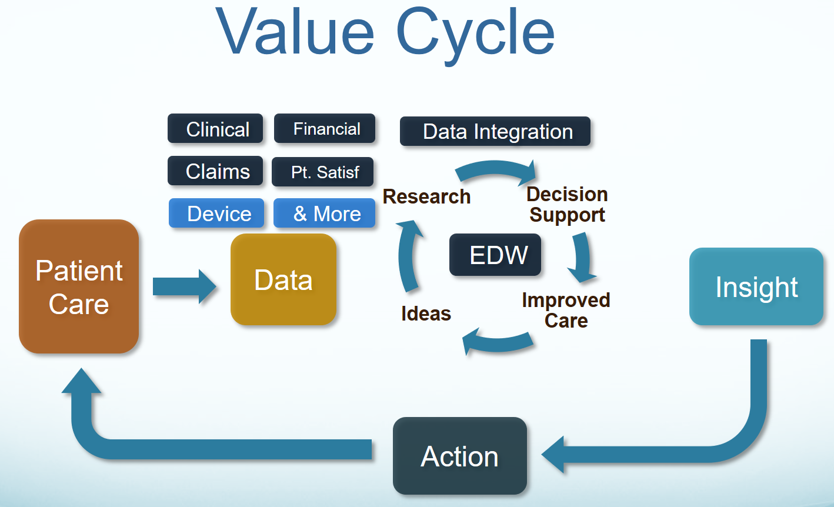
IT Objective
Our IT objective is to make the appropriate data available when it is needed, where it needed and how it is needed. We plan to integrate existing models, with semantically-consistent computable-data, including provenance data (who, what, when, where, why, how) across different platforms, e.g., Population Health, Care Coordination, Clinical Decision Support, EHR patient documentation systems, etc. using tooling to generate various implementation styles, including but not limited to HL7 Fast Healthcare Interoperable Resources (FHIR).
Notes:
Our IT objective is to make the appropriate data available when it is needed, where it needed and how it is needed. We plan to integrate existing models, with semantically-consistent computable-data, including provenance data (who, what, when, where, why, how) across different platforms, e.g., population health, Clinical Decision support, EHR patient documentation systems, etc. using tooling to generate various implementation styles, including HL7 Fast Healthcare Interoperable Resources (FHIR).

Slide 8
Objectives
=
Promote use of free & open models; foundational to interoperability
Maintain a clean separation of clinical model semantics using SNOMED, LOINC and RxNorm
Build upon and improve existing work; in particular DAF and FHIR core
Begin with the Integration of SOLOR+FHIM+CIMI+CQF+DAF=CLIM set of harmonized models, as the Enabling Foundation
Integrate tooling to support models to extend the utility of these asset
Use models and tools to generate standards and implementation artifacts
Advance in constructive steps through pilots and agile developments
Support with corresponding Communication, Interoperability & Governance strategies
SOLOR/FHIM/CIMI/DAF/CQF+ based FHIR Profiles
Satisfied Implementation + Clinical Communities
See Notes Page

Slide 9
Approach: Chronology Supporting Integration/Convergence
Where We’ve Been / What’s Ahead?
FHIM Value inquiry Sep 2015; Evaluation provided Jun 2016 FHA Managing Board
FHIM-CIMI Investigative Study presented Jan 2016 HL7 Wkgp Meeting
Core SME Framework established / SME Prep Sessions conducted to establish going- forward integration strategies
FHA, DoD/VA IPO and ONC/OST co sponsorship obtained
ONC Annual Meeting & May 2016 HL7 Wkgp Meeting leveraged to develop outline promoting two-day event aimed to increase awareness, support and collaboration
CIMI began contributing to FHIR QICore profile creation in May 2015
Early August Pre Education Seminars provided to offer base knowledge
Aug 17-18, 2016 Information Modeling Technical Forum
DoD/VA IPO FHIR Proving Ground JET assessing utility of MDHT/MDMI tooling
Status/Recommendations provided FHA Managing Board, 7 Sep 2016
Findings/Recommendations / Project Scope Statement presented Sep 2016 HL7 Meeting, e.g., initiate proposed draft standard steps; co op applicable workgroups
Event Report Out to key Stakeholders /Pilot Engagement (Oct / Nov 2016)
Initiate Pilot Engagement / Governance and Communications Framework
See Notes Page
Notes:
CHRONOLOGY:
2008 Federal Health Information Models start
2011 Clinical Information Model Initiative (CIMI) start
2016-01-16 CIMI Sponsored HL7 Investigative Study start
The Jan-Sep 2016 CIMI-Sponsored HL7 CIMI-FHIM Integration Investigative-Study includes: The Open Group Healthcare Forum, HL7 CIMI WG, HL7 EHR WG and HL7 CIC WG
2016-03-01 CIMI-FHIM Integration Task Force
2016-08-15 “CIMI-FHIM-SOLOR-CQF Integration” Preliminary Report
2016-08-17/18 Health Interoperability and Exchange Alliance (HIEA) Technical Forum
Health Interoperability and Exchange Alliance (HIEA) Technical Forum
Topic: Information Modeling: Foundation to Semantic Interoperability
C0-Sponsors: ONC OST, FHA, IPO DOD VA
This Health Interoperability and Exchange Alliance (HIEA) Technical Forum on “Information Modeling: Foundation to Semantic Interoperability” event was a key component of a mix of collaborative activities. This event had key stakeholders coming together under the facilitation of the DoD/VA IPO ONC Liaison, Nona Hall, BSN, MA who on behalf of the co-sponsors and through the support of the IPO's HIEA Technical Forum showcased this initiative and results to date.
As we go forward, there is logic to stay connected no matter what current and immediate task we are attending to.
2016-09-07 FHA “CIMI-FHIM-SOLOR-CQF Integration” Report PPT-Brief to FHA Federal Partners
2016-09-15 “CIMI-FHIM-SOLOR-CQF Integration” Final Report
2016-09-17 through 23 HL7 Meeting in Baltimore, MD
“CIMI-FHIM-SOLOR-CQF Integration” Report PPT-Brief at HL7
HL7 FY2017 “CIMI-FHIM-SOLOR-CQF Integration” Project Scope Statement (PSS) vetted at HL7

Slide 10
Approach Considerations
No action: to not act sustains the here-and-now, my-plate-is-full condition as well as stove-piped, discordant efforts = unacceptable
Stovepiped efforts: no one asset can offer needed semantic interoperability solution: Integration (of models/tooling) a must!
Efforts must be comprehensive & SME Driven
What matters to modeling community can be seamless to what impact we produce, e.g., improved FHIR Profiles
Persist via series of Pilots to apply lessons learned to
Refine Integration / Project Steps
Communication and Governance Strategies
Promote Min/Max Approach to support timely & feasible model releases for implementation
Engagement Strategy has to resonate with FHIR achievements / needs
Produce fully formed, domain-driven set of new or reused resources that are then used in profile(s) as necessary.
Leverage gains already achieved via initiatives, e.g., DAF, CQF, SDC, etc
Notes:
Given some are concerned over what is a ‘slow churn’ to gain DCMs, a Min/Max Approach will be explored. Ideally the SMEs would identify the ‘minumum model dimensions’ which supports an earlier release cycle while working and identifying the more detailed (Max) model dimensions that could be supported as & if feasible.

Slide 11
Approach: Argonauts and CIMI
We agree with the efforts of the Argonaut project
Current scope of the Argonaut work however, will not achieve true plug-n-play interoperability
Meaningful use common data elements
DAF profiles (high level profiles)
Small number of detailed models
Vital signs (measurements only, no qualifying information)
CIMI adds detailed content for plug-n-play interoperability
Lab measurements
Patient measurements
Physical exam
Intake and Output
Assessment instruments: Apgars, Braden, Pain Scales, etc.

Slide 12
Recommendations: Demonstrate the Viability of Integration Via Pilots
Identify the Project with willing parties that will implement the outputs including enhanced FHIR Profile for the Project
Create domain analysis model (DAM)
Identify the data elements needed to support the project and / or the clinical content gaps in FHIR
Identify the FHIM classes and FHIR Profiles that support the data elements; address gaps, as needed
Make the detailed CIMI models utilizing SOLOR for the source of terminology / vocabulary
Place model in a registry that is publicly available
Approve the model
Construct application (s)
Test the FHIR Profile / application for compliance with the model and standards
Put the application in production use & evaluate its value
Parallel Activities: access to SOLOR Terminology Server; model harmonization / maintenance; access to people & EHRs
See Notes Page

Slide 13


Proposed Solution Integrated Model Stack - Each Plays a Role
KNART
KNART
KNART
DCM
DCM
DCM
DCM
DCM
CQI
C QF
CDS
DCM
DCM
Other
Initiatives
DCM
CIMI
FHIM
DCM
DCM
DCM - Detailed Clinical Models
FHIM – Federal Health Information Model
KNARTS – Knowledge Artifact
SOLOR – SNOMED, LOINC, RxNorm
SOLOR
See Notes Page
Notes:
As shown in this slide, each model contributes to an Integrated Model Stack, the proposed operational architecture involves the definition of clinical knowledge in the form of formally modeled information artifacts that could be used in compose-able health records, care plans and other shared clinical data. As represented in this slide, the combination of SOLOR, FHIM, CIMI DCMs and CQF KNARTs while complementary fulfill a different information modeling contribution.
SOLOR is SNOMED with extensions for LOINC and RXNorm.
FHIM is Federal Health Information Model
CIMI DCMs is Clinical Information Model Initiative Detailed Clinical Model
CQF KNARTs is Clinical Quality Framework Knowledge Artefacts

Slide 14
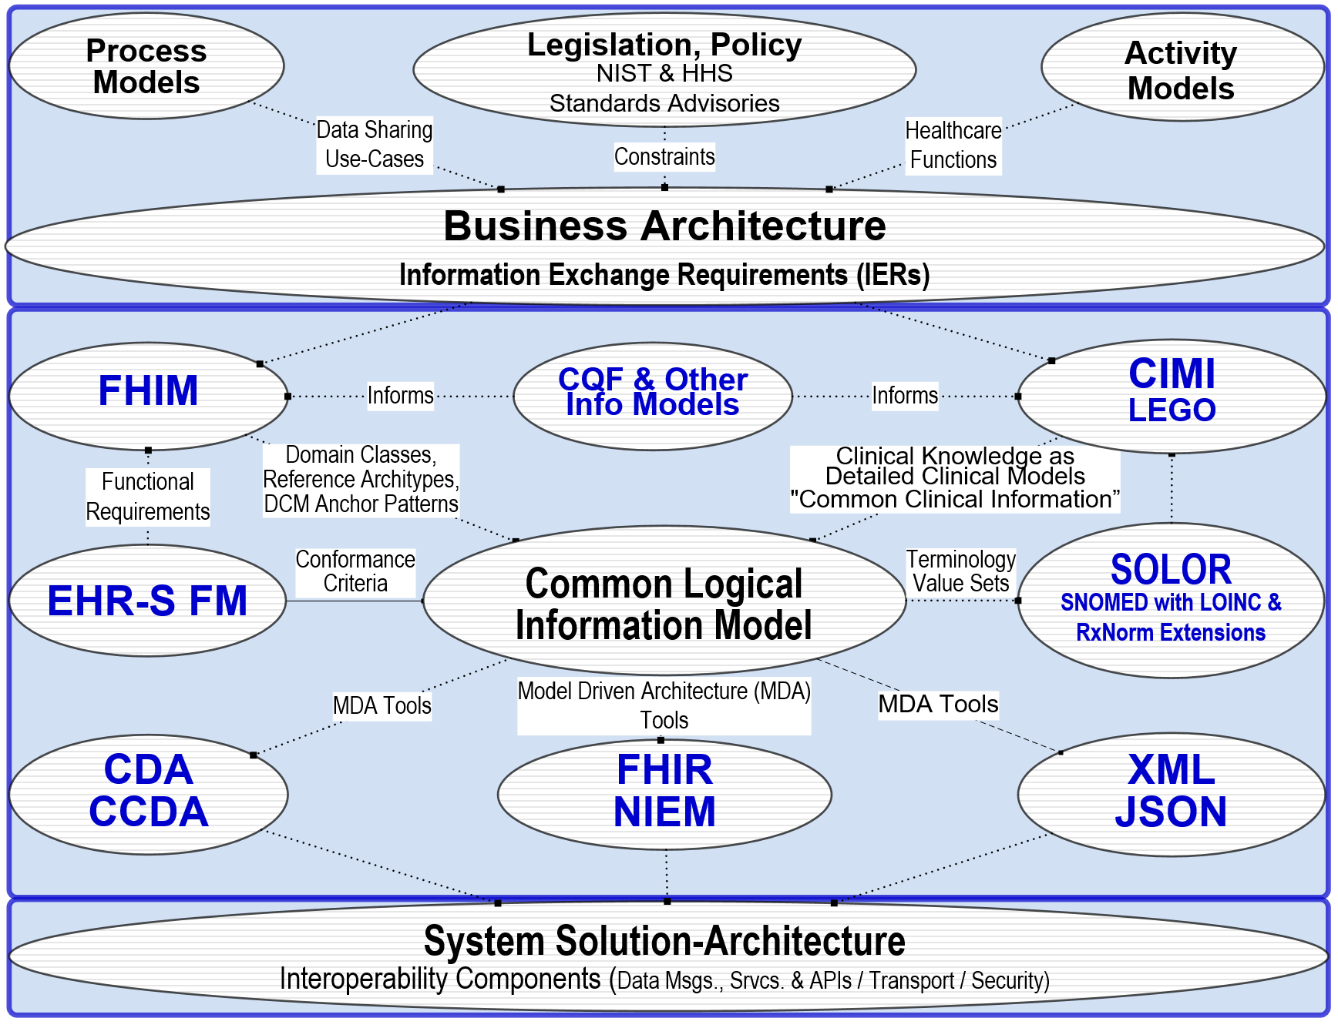
Proposed Solution High Level Architectural View
The proposed solution involves the definition of clinical knowledge in the form of formally modeled information artifacts that could be used in compose-able health records, care plans and other shared clinical data. Each information artefact will be defined with an unambiguous and computable meaning, employ a specific, shared vocabulary, and have a specific information structure.
See Notes Page
Notes:
The High-Level Architectural-View slide shows how CIMI-FHIM-SOLOR-CQF Integration enables Consistent “Foundational Health Information” and “Common Clinical Information” to support Computable Semantic-Interoperability in “Continuum of Care” Implementations and aggregated, portable and computable patient-records, care plans, clinical knowledge and other shared healthcare information.
The top Business Architecture typically includes:
Legal, ethical requirements, policies and rules
Societal/organizational (e.g., cities, states and countries) requirements
EHR-system requirements
Vocabulary (Shared: Syntax, words, phrases)
Ways to present and enter data via screens, forms, etc.
Notions about archiving/documentation/information security
Care quality measurement and improvement through clinical knowledge
The center Information architecture, includs:
FHIM, EHRS-FM and CQF, which consolidate Health domain requirements
CIMI and LEGO; where, LEGO is the Q&A subset of CIMI, using the CIMI Observation Model and Description Logic.
Other Info Models, e.g., CQF, SDC, DAF, V2, CCD, etc. –
SOLOR Terminology and Value Sets based on SNOMED-CT expressions.
The bottom Solution Architecture includes:
EHR-systems with CCDA, FHIR, NIEM, JSON API, RDF, HL7 V2 & V3 interfaces among EHR-system Services.
Supporting services (Terminologies, Terminology servers (e.g., SOLOR), Value set servers, Protocol servers, Clinical guideline servers, clinical decisions support servers, Presentation/data input services, Exchange services)
Technical Infrastructural services: networks, internet, information security,
Hardware and Software
with a clear separation of semantics.

Slide 15
Proposed Solution: Guiding Principles
Follow existing CIMI Principles and modeling style guidelines*
The modeling SMEs recommend adding the following foundational principles:
a clean separation of clinical model semantics
using SNOMED, LOINC and RxNORM
* See CIMI Practitioners’ Guide at https://1drv.ms/w/s!AlkpZJej6nh_k6ZUeG7W6TaWcbTZ4Q
See Notes Page

Slide 16

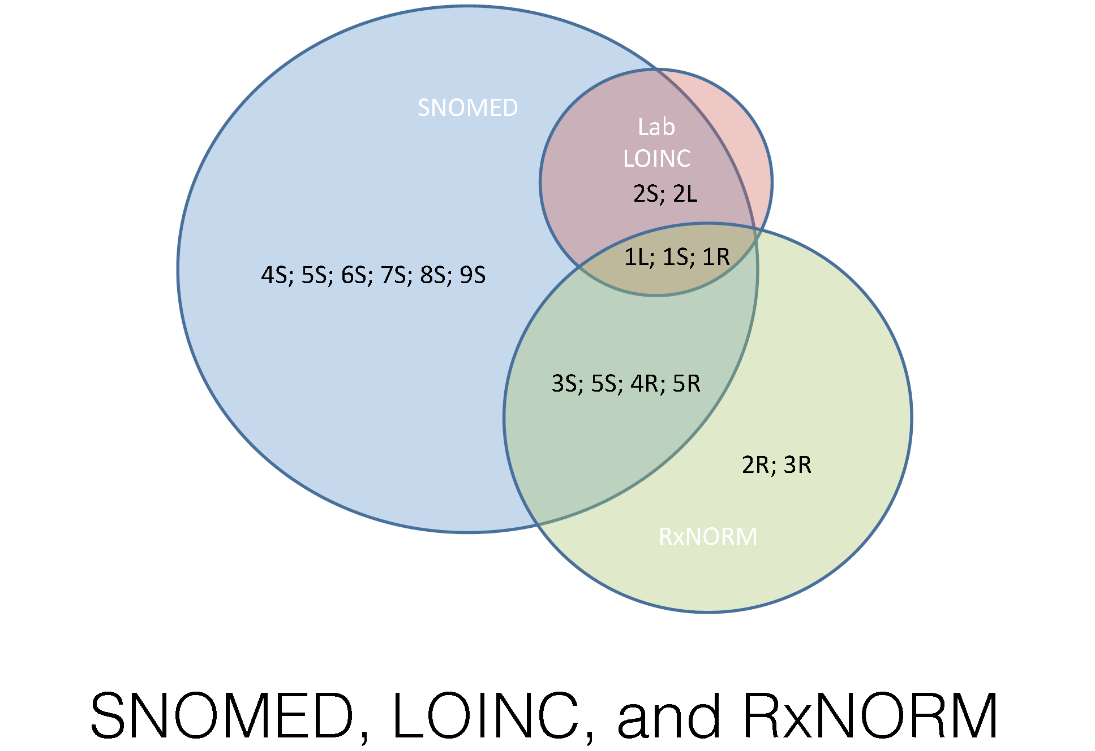
Proposed Solution Terminology Foundation
Terminology Problem SOLOR Solution
Serving as Terminology Foundation
SOLOR Benefits: Normalized structure and form of clinical terminology improves software reuse, shared tooling, reduced learning curve, shared post-coordination models, simplified data analysis … no more mapping!
See Notes Page
Notes:
Gentamicin is an example of the non-consistant terminologies
Why we can simplify now?
• Licensing models have changed so we can implement native standards
• LOINC and SNOMED are integrating content via a shared logical model
• RxNorm can be extracted into a shared logical model
• SNOMED + LOINC + RxNorm + post-coordination provides comprehensive coverage for typical clinical data representation requirements
In distinguishing terminology and model capability: Concrete Example In SOLOR / RxNorm = description of dosage of penicillin and what it means; With the use of the FHIM it will tell you if its part of substance administration and/or adverse event. RxNorm doesn’t do that
CIMI offers a DCM the providers can use in the detailed execution of a particular domain

Slide 17
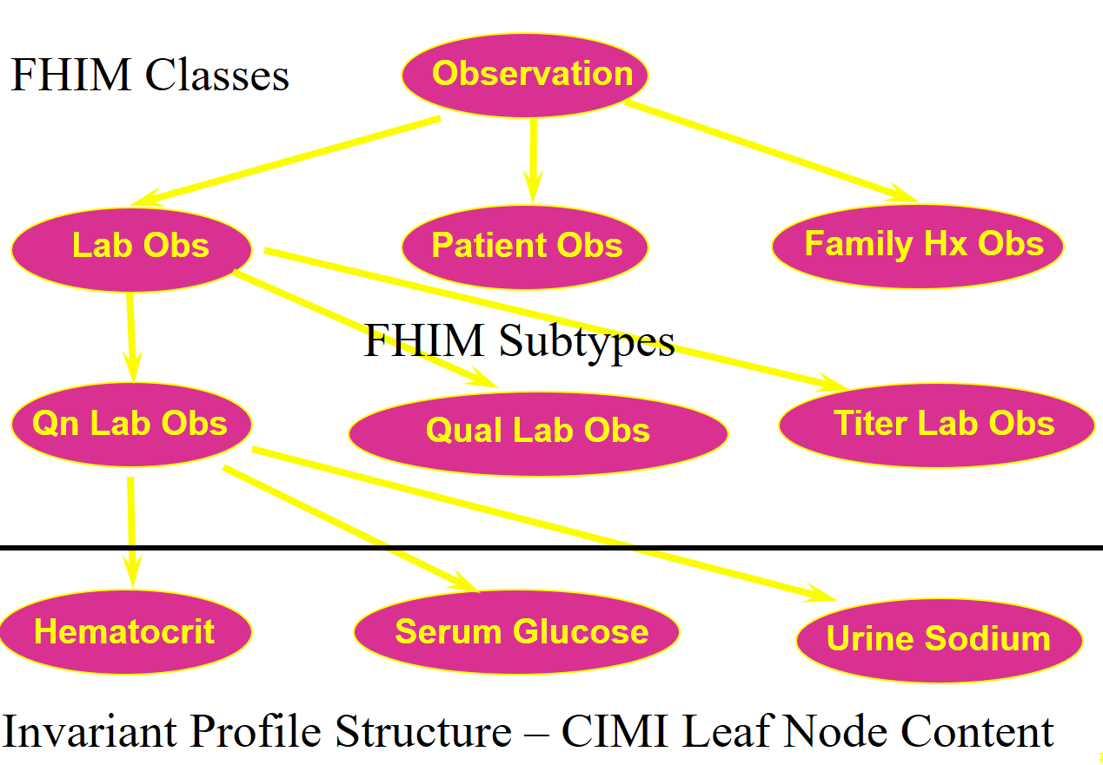
Clinical Example CIMI-FHIM Integration
CQF Knowledge Artifacts
SOLOR Terminology
FHIM Classes
CIMI DCMS

Slide 18
Graphic of a Detailed Clinical Model
SystolicBPObs
SystolicBP
data
138 mmHg
LOINC
quals
BodyLocation
BodyLocation
data
Right Arm
PatientPosition
PatientPosition
SNOMED CT
data
Sitting
5

Slide 19
FHIM Information Domains - Modeling Status
(as of Oct 2016)
FHIM Information Domains
Information Domain | Information Modeling Status | Terminology Modeling Status
AdverseEventReporting | Complete | Complete
Allergies | Complete | Complete
Assessment | Complete | Baselined
Audiology And Speech Pathology | Baselined | Baselined
BehavioralHealth | Partially Complete | Baselined
BloodBank | Baselined | Baselined
CarePlan | Complete | Complete
ClinicalDecisionSupport | In Progress | Baselined
ClinicalDocument | Baselined | Baselined
ClinicalObservation | Complete | Complete
Consultation | Baselined | Baselined
Dental | Baselined | Baselined
Dietetics | Baselined | Baselined
Encounter | Complete | In Progress
EnrollEligibilityCOB | Complete | Baselined
HealthConcern | Complete | Complete
HomeBasedPrimaryCare | Baselined | Baselined
Imaging / Radiology | Complete | Complete
FHIM Information Domains
Information Domain | Information Modeling Status | Terminology Modeling Status
Immunizations | Complete | Complete
Lab | Complete | Complete
OncologyRegistry | Baselined | Baselined
Orders | Complete | In Progress
PatientEducation | Baselined | Baselined
Person | Complete | Complete
Medications/Pharmacy | Complete | Complete
Prosthetics | Baselined | Baselined
Provider | Complete | Complete
Public Health Reporting | Partially Complete | Baselined
SecurityAndPrivacy | Complete | Baselined
SocialWork | Baselined | Baselined
SpinalCord | Baselined | Baselined
Surgery | Baselined | Baselined
VitalSigns | Complete | Complete
WomensHealth | Baselined | Baselined
Common | Complete | In Progress
Datatypes | Complete | Complete
In production
2

Slide 20
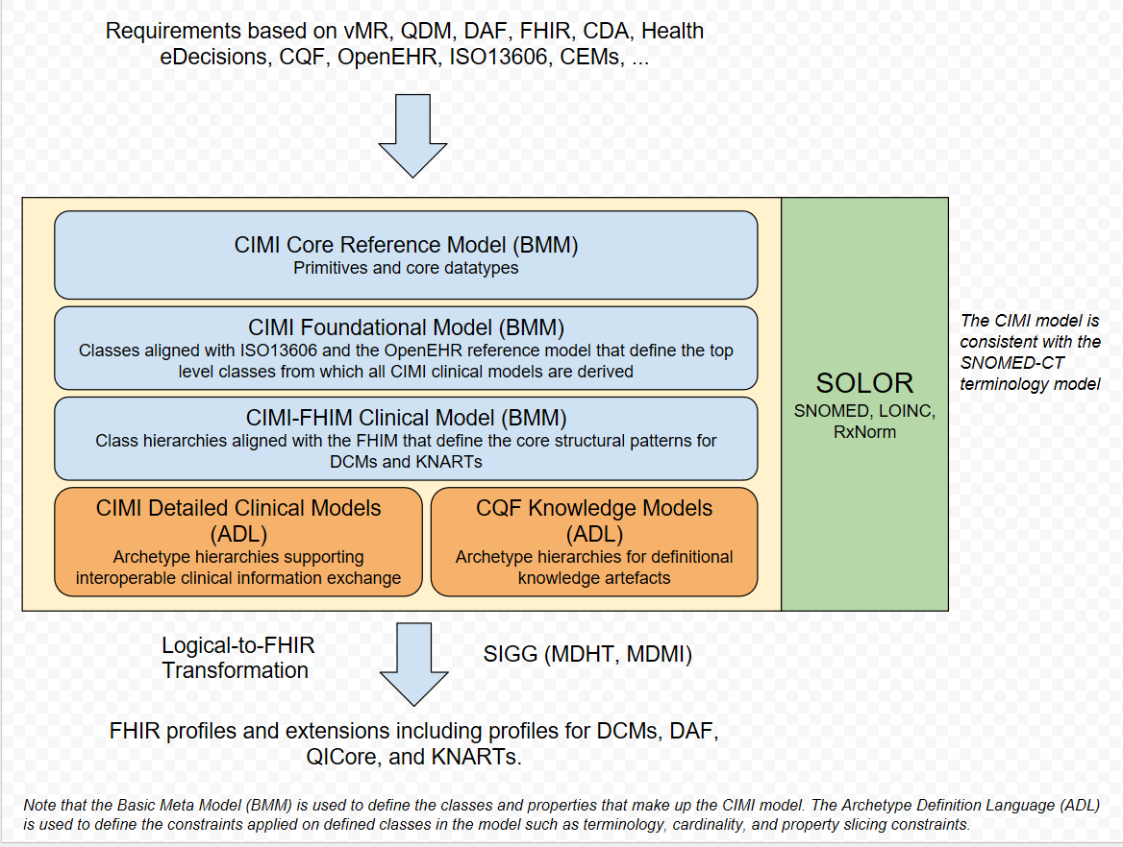
Model Driven Architecture Vision to seamlessly support developers and implementers
See Notes Page
Notes:
Claude Nanjo, https://docs.google.com/drawings/d/1xQF5SZxwi8DiFG1C7uI9eBo6RkgYtA3iIekeuDOC8Es/edit
The core reference model which define the very foundations of the model. Right now, it is very generic. It can almost be compared to FHIR's Structure Definition with some of its datatypes, etc... At this time, it is really a meta-model layer.
The foundational archetype layer - these are closely aligned to ISO13606 and the OpenEHR reference model and provide the foundation for a clinical document more generally and a clinical record in the case of CIMI. This is important because KNARTs can use this same foundation as well which is key when we define a logical model for CQF.
The reference archetype layer - these will consist in the case of CIMI of the 'schematic anchors' so to speak (to borrow Richard Esmond's term) from which detailed clinical models will be derived. Requirements for this layer will come from FHIM, vMR, QDM, QUICK, FHIR DAF, SDC, etc... The goal is to define this layer so that the transformation cost to FHIR profiles is lowest despite some divergence which we know we will have. Note that within the hierarchy of archetypes that will make up this layer, we will derive the DAF and QICore profiles. However, I would not call this layer the FHIM/DAF/QICore layer. It is more than that. Also, as Galen pointed out, not all of the expressivity of FHIM will carry over to CIMI given the models' different requirements.
The detailed clinical model layer which, ideally, are simply constraining profiles on the layer above to create families of archetypes that only vary in their terminology bindings and cardinality constraints.
An additional note on the Reference Archetype Layer: There will ultimately be two general categories of archetypes in this layer - the CIMI archetypes which we are working on now as part of the CIMI/FHIM effort - and the HeD archetypes which will consist of those archetypes that define the CQF logical model. Note that for both of these categories, there might be common archetypes used for both CIMI and HeD (e.g., the procedure topic of a clinical statement in CIMI can also be used as a definitional archetype for a procedure order item - ActivityDefinition - in an order set for instance).
Then, from layers 1-4, we would define the set of transformations to generate the corresponding FHIR profiles including DAF and QICore. Note that FHIR profiles can be generated from the various levels of the archetype hierarchy depending on requirements. The lower down the hierarchy, the more prescriptive the profile in terms of constraints.
It is important to note that some FHIR profiles may be derived from the Reference Archetype Layer (e.g., DAF, some QICore profiles, some CQIF profiles on PlanDefinition, Questionnaire and ActivityDefinition, etc...) and others from the DCM Layer (e.g., bilirubin, HgA1c, etc...). In other words, the arrow for FHIR Profiles stems out of the outer box rather than the last of the inner boxes (the DCM box).
CQIF is an implementation guide that stems out of the CQF initiative. I hope this helps.

Slide 21
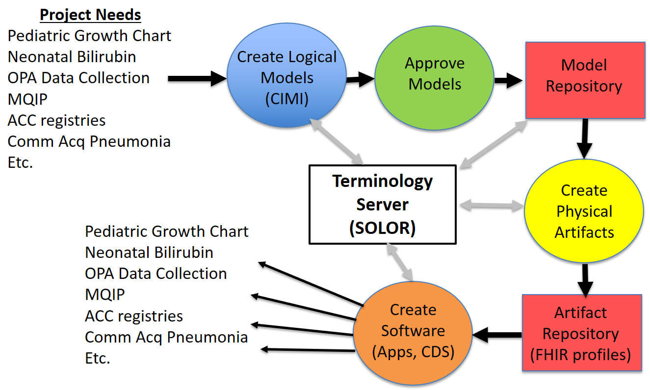

Proposed Solution Apps based on Integrated/reusable Models
CLIM
{SOLOR, FHIM, CIMI, CQF, …}
CLIM
(HL7/ISO
Balloted
Version)

Slide 22
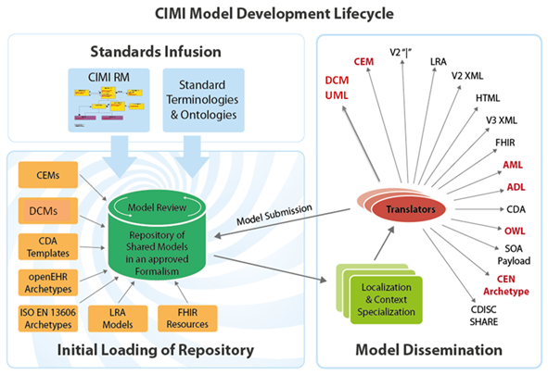
Standard
Terminologies
(SOLOR)
LEGOs
FHIM

Slide 23
Working with FHIR Resource Owners
DAF
FHIR Profile
FHIM
CIMI
(logical
model)
openEHR
Feedback
(constraint)
(constraint)
DAF (derived from CIMI)
(Different realms
and use cases)
Other
FHIR
Profiles

Slide 24
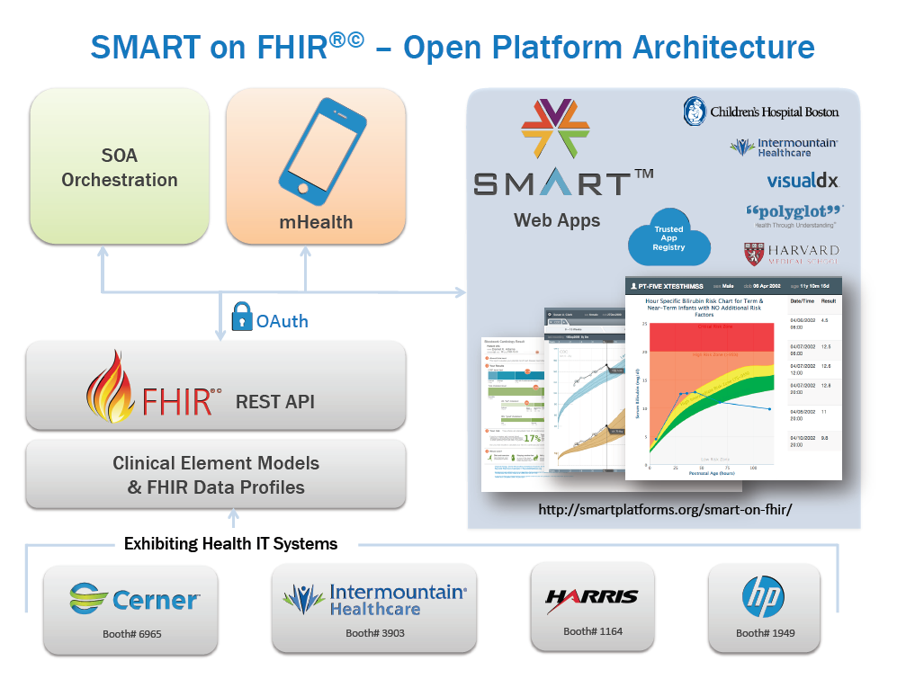
FHIR Profiles from CIMI Models
(using standard terminology)
Heterogeneous Systems
24

Slide 25
Tooling Vision / Challenge; where, tools
seamlessly support developers and implementers
Requirements derived from business use-cases, SMEs
Requirements derived from existing specifications
Tools using Terminology Model and Content
Versioned SNOMED, LOINC, RxNorm (SOLOR)
(Terminology model & Terminology Content)
clinical requirements (reusable DCMs)
Versioned CLIM = {SOLOR Term., FHIM Domains,
QDF{(DAF, QICore, KNARTs, eCQMs}, CIMI {DCMs}}
MDA Tools (e.g., SIGG = MDHT + MDMI)
UML Profile: KNART
UML Profile: CDA
UML Profile: FHIR
UML Profile: NIEM
UML Profile: DCM
Use round-trip to confirm process
NIEM IG
NIEM IG
NIEM IG
NIEM IG
NIEM IG
NIEM IG
NIEM IG
NIEM IG
ADL & AML
CDA IG, Java, XML
FHIR IG, Java, JSON
NIEM IG.
ADL & AML
Mappers
Translators
See Notes Page
Notes:
FHIM and SIGG (MDHT and MDMI) have the capability for generating implementation models. With the adoption of CIMI information requirements (informed by FHIM), we could generate CIMI archetypes and compare them to the source archetypes to confirm the process. FHIM & MDHT could then serve as one of the “translator” tools CIMI intends to develop.
———————
CLIM
For tool type activities, I would add a balloon pointing to Terminology model & Terminology Content that says something like “add new terminology content as necessary to meet requirements derived from existing specifications.
Then add a versioning and publication step between the SOLOR box/layer and the CLIM box/layer.
Then add a versioning and publication step between the CLIM box/layer and MDHT/MDMI. I think the arrows you are using conveys publication, so you could stick with that metaphor.
For the box MDHT/MDMI, I would not put IHTSDO workbench in that list, it would be more in the SOLOR box/layer balloon.
For the other goods, ADL workbench, enterprise architect, etc, they need to be able to import SOLOR content, so they can build the profiles using the agreed terminology foundation…
ACTION (Jay) Please update slide IAW with Keith’s guidance.
ORIGINAL NOTE
SOLOR
Creates Lightweight Expression of Granular Objects using SNOMED, LOINC, RxNorm within Detailed Clinical Models. It is an integration of SNOMED, LOINC, and RxNorm that can be treated as a single, coherent terminology systems with description-logic semantics.
FHIM
is Federal Healthcare Information Model, which is a high-level logical healthcare model, which covers approximately 36 clinical domains and has been vetted by Federal Agency SMEs and clinicians.
CIMI
is Clinical Information Model Initiative which defines Terms-of-Reference AKA Principles and modeling style guidelines; where, a CIMI Model is a clear, complete, concise, correct and consistent logical semantic-and-syntactic description of a healthcare concept, which can be instantiated as a computable implementation object that is interoperable among systems.
FHIR
defines a set of "Resources" that represent granular clinical concepts. The resources can be managed in isolation, or aggregated into complex documents.
CQF
is Clinical Quality Framework to support Continuous Quality Improvement (CQI) with a Quality Improvement and Clinical Knowledge or QUICK data model, Clinical Quality Language (CQL) supporting clinical decision support (CDS) and clinical quality measures (CQM).
Others
Standards Coordination initiatives (DAF, SDC, etc)
Interoperability Proving Ground
MDHT
MDHT is a suite of tools that is used to support the design and implementation of healthcare standards
MDMI
MDMI is an open standard (OMG) that specifies a UML Model for interoperability
For the FHIM, MDMI provides semantic alignment between the different Interoperability specifications and different logical models
SOLOR Terminology Model ….what it really means
FHIM = Use
CIMI = Offers via DCMs the specifics supportive for detailed applications
FHIM = Provides the conceptual / logical view of all the data in your enterprise even though you would never build it that way; it none the less is there to consistently offer all the spokes that need to come together anchoring them all via the hub. It gives you common language all can talk Grants that understanding to the semantics Treat FHIM as in support of what’s needed for a shopping list whereas you are collecting the necessary components. With
CIMI is the taxonomy among the terms
C-CDA is about the data sharing
FHIR is about transport model; standardizes the FW built for moving resource / enables the exchange of info within the system and ideally it will conform to the FHIM/CIMI;
Domain model: An explicit description of a domain in terms of concepts, properties and attributes, and constraints, defining a common vocabulary. Domain model characteristics: Closed (but extensible), useful for defining objects, properties, and relationships, often (not exclusively) expressed in UML. Sometimes called “conceptual” or “domain analysis” model.
Example: Pressure Ulcer Prevention Domain Analysis Model (http://wiki.hl7.org/images/b/be/PressureUlcerPreventionDomainAnalysisModel_May2011.pdf)
Information model: A representation of what data is associated with a domain and how that data is structured. Similar to a domain model, but with a focus on representing the information associated with the domain, rather than the domain objects themselves. Information models commonly are developed at the logical level, that is, they are specific about what data is captured, but do not specify database structures. Should include metadata (information about the information collected). Information model characteristics: Closed, includes metadata, useful for constructing artifacts using Model-Driven Architecture.
Example: FHIM
Ontology: A formal naming and definition of the types, properties, and interrelationships of the concepts that really or fundamentally exist for a particular domain. An ontology can be developed for specific domain model or it can also be used across multiple domain models. Ontology characteristics: Open, useful for automated reasoning, often (but not exclusively) expressed in OWL.
Example: SNOMED-CT
Taxonomy: A taxonomy is similar to an ontology, but taxonomy is usually only a hierarchy of concepts, while an ontology supports complex relationships between concepts.
Example: CMS Healthcare Provider Taxonomy Code Set (https://www.cms.gov/medicare/provider-enrollment-and-certification/medicareprovidersupenroll/taxonomy.html)
Data Element: A unit of data for which the definition, identification, representation, and permissible values are specified. May not, in itself, provide complete context. May also be posed as a question-answer pair.
Example: US National Library of Medicine Data Element Catalog (https://www.nlm.nih.gov/healthit/dec/)
Exchange Package: A set of information that is transferred between systems. The logical contents of exchange packages will be defined in terms of individual or groups of data elements. The logical content is independent of the wire format (syntax), but often the definition of an exchange package includes a specific syntax (how the information is serialized for transport).
Example: HL7 V2.5 ADT message, Continuity of Care Document
Transformation (often just called mapping) is the process of mapping between data fields and the translation of terminology needed when the source information model, the local contents of the exchange package, or the target information models are not identical.
FHIM / CIMI are information models (conceptual / logical) they are not physical / implementation models
HL7 2.3, 2.8,3.0 separate chunks of data to get transported…..transport mechanism – more about data sharing

Slide 26
Data Mapping & Transformation: MDMI
Model Driven Message Interoperability (MDMI)
Eliminates mapping chaos
Use UML model for each source/target spec, including FHIM
C-CDA
C-CDA
FHIR
FHIR
HL7 v2
Business Element Dictionary
HL7 v2
FHIM
FHIM
CIMI
CIMI
NIEM
NIEM

Slide 27
FHIM to FHIR using SIGG
FHIM
FHIM
MDMI Framework
FHIM
To
Target
Deltas
Implementation
FHIR Profile
RI *
Compare
Generate
Target
Creates
Uses
Created using MDHT
Uses
FHIR UML
Gap and
Traceability Report
FHIR
Generate
Profile
* RI – Referent Index
See Notes Page
Notes:
SIGG = Standards Implementation Guide Generator

Slide 28
MDA Proof of Concept Deliverables
Working Software (Reusable & Extensible)
Model to Text report generation component
Model to Model MDMI Framework
Completed Artifacts
Generated Traceability and Gap Analysis Report for Allergies
Generated UML FHIR Profile for Allergies
FHIM UML Model annotated with MDMI for Allergies
FHIR UML Model annotated with MDMI for Allergies
Report
Use Case Report detailing efforts and findings
See Notes Page
28
Notes:
The POC for the MDA framework was to leverage and extend the existing assets available to and investments made by the ONC and the other federal agencies. The POC leverage existing working software used in the SAMSHA work using the MDA framework to automate creating logical semantic models from FHIR (and other Information Models such as CCDA and the FHIM) as well as in the HL7 SOA Cross Paradigm Interoperability Project which provided the traceability component of the Traceability and Gap Analysis Report. Additionally, the MDHT assets used by the ONC, the VA, NIST, and others is an integral part of the MDA Framework. The existing FHIM asset was also incorporated into the framework.

Slide 29
The Repeatable Process Framework
A Repeatable 4-Step Process:
Annotate FHIM Model (Once)
Annotate Target Model (FHIR, or other)
Using FHIM and Target
Generate Traceability and Gap Analysis
Generate Implementation (if applicable)
Using Target
Generate MDMI Map*
Repeat Steps 2 through 4 for other target models (C-CDA, VA, DOD, etc.)
* Generate MDMI maps to enhance interoperability exchange development
See Notes Page
29
Notes:
The previously implemented transformations use specific metadata embedded within FHIM models to support the transformation to a target model. The proposed FHIM to FHIR transformation using MDMI is based on an initial proof-of-concept architecture framework that uses the following repeatable process as well as re-useable software components of the MDA Framework:
1 Annotate the FHIM using MDMI RI
2 Annotate the target platform specific model using MDMI RI
3 Designate FHIM elements to be transformed
4 Using the FHIM MDMI Annotations, identify the corresponding target UML structure(s)
5 Using a target specific compare extension, identify the series of element additions, deletions, and modifications
6 Using a target specific model extension and the list of elements, generate the target platform UML for the profile classes
7 Use the target platform UML transformation to generate the corresponding artifacts, e.g. FHIR StructureDefinition

Slide 30
SIGG Road Map
SIGG Going Forward
Provide support for IPO FHIR Proving Ground JET, Phase 2
Complete design and implementation of FHIR specification import/export to UML for HL7 balloted FHIR STU 3
Enhance functionality of automated FHIR profile generation from UML
Integrate terminology services for analysis of value set mapping
Expand scope and use of FHIM content mapping
Enhance traceability and gap analysis reporting
See Notes Page
Notes:
Agency Targeted review of content and tooling
Demonstration, design review, code walk-through
Expand scope and use of FHIM content mapping
Expand annotation of FHIM and FHIR models beyond allergies
Pilot project with government agency SME users
Enhance traceability and gap analysis report
Interoperability measurement column, Condition column, more complete information from FHIR and C-CDA models
Complete design and implementation of FHIR specification import/export to UML for HL7 balloted FHIR STU 3
Enhance functionality of automated FHIR profile generation
Using FHIM to FHIR traceability and gap analysis
Integrate terminology services for analysis of value set mapping
Partial automation of value set equivalence or differences
Content Services – Integrate PHINVAD or VSAC
Binding – Update binding approach with the FHIM etc to follow HL7 Vocabulary group

Slide 31
Clinical Impact – Benefits & Advantages
MDA
(MDHT & MDMI)
CLINICAL
IMPACT
Consistent Representation of
UML Implementation Guides:
Provide a consistent approach for constraint-
based profiling using UML, thereby enabling
a common model-driven process and tooling.
Applicable to: CDA, FHIR, FHIM, CIMI, etc.
Development Cost Reduction:
Less time and resource investment for
analysis and implementation of CDA & FHIR
implementation guides
Maintenance Cost Reduction:
Access to high-quality, domain specific
APIs generated from specification models,
providing programmatic access to
content and validation of conformance rules
Support Design Tasks:
Import existing HL7 specs to UML
Integrate with terminology services to
define and reference value sets and codes
Generate instance validation tools from
specification models
Publish implementation guides in
multiple formats (PDF, XHTML, etc.)
Health
Information
Exchange
Interoperability Mapping:
Content mapping, traceability & gap analysis
between models via reference to
common semantic metadata
Clinical Decision
Support
Population – Health
Care Coordination
Specification
Designers
Research & Analytics
Developers /
Implementers
Quality – Outcome
Cost Measurements
Quality/Cost = Value
Learning Health
System

Slide 32
Recommended High Level Work Breakdown
Governance
Pilot Project Selection and Development; Options
Skin Assessment / ADL / PC Wound Care*
Medication List, enhance FHIR Resource
Document Types discordance between DoD and VA
ACOG “Data Elements”
CQF – FHIR – Argonaut opportunities
IPO-sponsored FHIR JET assessing SIGG (MDHT / MDMI tooling)*
DoD/VA Health Data Sharing Business Line Workgroups (Population Health)
Plan of Care Order Transcription / Resulting challenges
Explore use of FHIM to support EHR System Functional Model
Connectathon outputs
Others
Communication
* Recommended/Underway
See Notes Page
Notes:
Another tool being assessed is ShEx via David Booth via DoD interest; MDHT/MDMI is via FHA interest
From final report:
Initial Work Breakdown Structure (see MS Project version at end for details)
High level work breakdown areas include:
Governance
Pilot Project Selection and Development
Communication
Continued legacy mapping makes sense in the short term. The Model Driven Architecture (MDA) makes sense in recommended long-term future-state and beyond; and a hybrid transition strategy makes sense in the mid-term.

Slide 33
Recommended: Skin Assessment / ADL / PC Wound Care
Skin and wound assessment are a good first step because
In addition to DoD and VA, we bring input from a wide community of international and clinical groups
it can be integrated into quality assessments and decision support that improve clinical care
it brings in new resources (nursing community) that can have general applicability
it begins the process of allowing us to evaluate and influence existing resources and (FHIR) profiles that might be improved by our principles & evolution of processes

Slide 34
Attributes of Success
Increased awareness related to Information/Tooling/Mapping & Integration efforts accenting on Distinction and Utility
Advocacy to insert and jump start routinely with (formal) information Modeling Assets into projects and standards development efforts
Advocacy to support follow-on efforts / Implementation Practicality
Sustain Core SME Framework / Expand / Invest in building upon current SME base
Apply insights / recommendations from all efforts to date, e.g., Info Modeling Tech Forum
Build out near term, mid term & long term efforts via work breakdown supporting Pilots
Assess / layout resourcing implications tied to report
Capitalize on follow up Modeling Meeting with FHIR colleagues and establish Process Engagement Strategy
Final report during the Sep 2016 HL7 Workgroup Meeting in Baltimore
Approved Project Scope Statement promoting HL7 Balloted CLIM on an annual basis (informative, DSTU1, DSTU2, Normative and CLIM & SIGG-tools use by EHR related developers, implementers and vendors
Sustain predictable stakeholder contact
Expand Communications / Outreach; Governance; Strategic Interoperability Planning
Supportive of Integration
Leverage opportunities to expand FHIM accessibility / usability and use by larger communities, e.g., HL7
Repurpose efforts / Replace building models to build models via active engagements
Acknowledge / enhance SME base, User Community Partnerships & Stakeholder Community Contacts to guide a shifting in commitments & to gauge progress.

Slide 35

Questions?
Thank You
Acronym Challenge for the Integration Effort
Acronym | Definition
ICE | Integrated Components for Everything Integrated Clinical Entities
ICCE | Integrated Clinical Components for Everything
FUEL | Federated Ubiquitous Expression Language
FHUIL (pronounced “Fuel”) | Federal Healthcare Universal Interoperability Language
The (CIMI-FHIM-SOLOR-CQF) Acronym challenge

Slide 36
Details
Supporting documents are viewable and downloadable at
HL7 Project Scope Stmt. https://1drv.ms/w/s!AlkpZJej6nh_k9dYlvNWaZ3DLPKSYg
Briefing Slides https://1drv.ms/p/s!AlkpZJej6nh_k9dE-b_DAO8HSNNT6Q
Slides-Notes Pages PDF https://1drv.ms/b/s!AlkpZJej6nh_k9daUH18BNQFOwtNrg
Final Report https://1drv.ms/w/s!AlkpZJej6nh_k9dQ2qQnRuQM8gbu8A
Technical Forum Summary https://1drv.ms/w/s!AlkpZJej6nh_k9gyRVADgOvM5SlJkQ
Preliminary Report https://1drv.ms/w/s!AlkpZJej6nh_k9YPmsR8Hl6zTlQ0NQ
Work Breakdown MPP https://1drv.ms/u/s!AlkpZJej6nh_k9dK5WOB8zkkUuaKgA
Work Breakdown PDF https://1drv.ms/b/s!AlkpZJej6nh_k9dfYSeXPGjTRJ2cAg
Work Breakdown XLSD https://1drv.ms/x/s!AlkpZJej6nh_k9dgBSgLrTfaKYcG2A
CIMI Practitioners’ Guide https://1drv.ms/w/s!AlkpZJej6nh_k6ZUeG7W6TaWcbTZ4Q
Some of these documents will be updated throughout 2016
Note that many networks block the use of clickable links; where,
You must copy the link into a browser to access the content.

Slide 37
Acknowledgement Collaboration that Grows with Strong SME Base
CIMI Co-Chairs
Linda Bird BIT, IHTSDO
Galen Mulrooney, FHA and VA
Harold Solbrig, Mayo Clinic
Stanley Huff, Intermountain Healthcare
Members of the following SDOs
IHTSDO, POC: Linda Bird BIT
HL7 Work Groups (PC, CDS, CIC, EHR, SOA, Vocab)
The Open Group Healthcare Forum, Jason Lee POC
ISO/CEN, POCs: Gerard Freriks, William Goossen, Gary Dickinson
Federal Agency staff and contractors
Department of Defense
Veterans Administration
Interagency Program Office
ONC OST and Federal Health Architecture
Members of the following Healthcare Organizations
Intermountain Healthcare
PenRad, Inc., Results4Care
HSPC and other interested parties
Faculty, Staff and students
The University of Utah
See Notes Page
Notes:
Subject Matter Experts from across the Federal, US, and International Community
With decades of experience, these ‘founders in this field’ view current circumstances ripe for integration
Champions from HL7 - CIMI / HSPC, FHA – FHIM, DoD, VA, IPO, ONC/OST via CQF, Open Group, FHIR, ISO Community
Accent via Biographies
Clinicians
Analysts
Clinical Informaticists
Computer Scientists, Engineers and Architects
Implementers
These SMEs are your best chance of success

Slide 38
Back Up Information
Omics Information in support of Precision Medicine

Slide 39
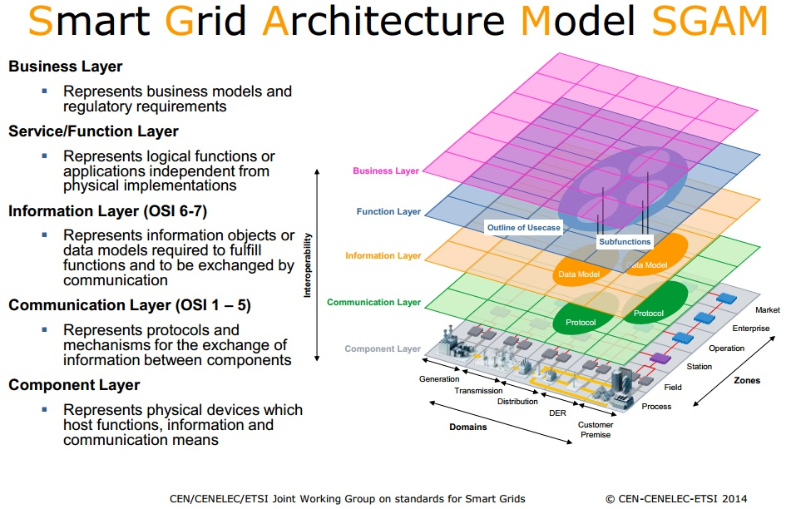
Interoperability and Modelling

Slide 40
DEFINITION - OMICS
‘OMICS’ as defined by the Institute of Medicine is the study of related sets of biological molecules in a comprehensive fashion. Examples of omics disciplines include genomics, transcriptomics, proteomics, and metabolomics.
Genomics is a division of genetics that involves sequencing and analyzing the genome which contains all of the DNA found in a single cell. Studying variability within the genome helps researchers and clinicians better understand health and disease.

Slide 41
Advancing Standards for Genomic Interoperability
Fast Healthcare Interoperability Resource Standard (FHIR) (www.hl7.org/fhir)
Well-defined data model and Application Programming Interface
Being supported by vendors and App developers
FHIR Genomics (www.fhirgenomics.org)
Extending the FHIR standard to support exchange of clinical genomics data between EHRs

Slide 42


OMICS Profile
Testing Standards Devices
Genomics
Transcriptomics
Metabolomics
Proteomics
Microbiomics
Clinical Care Innovation and Decision Support
Precision Medicine
Data Integration
Care Delivery Patient Interactions

Slide 43
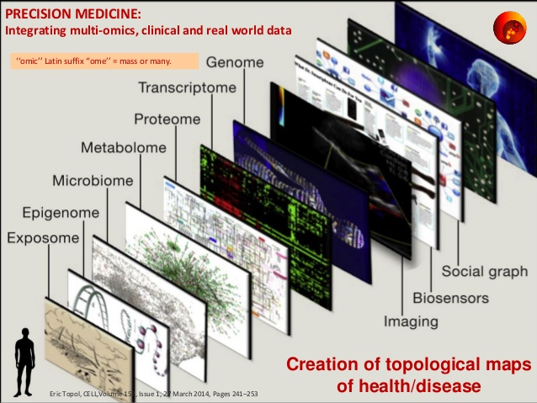
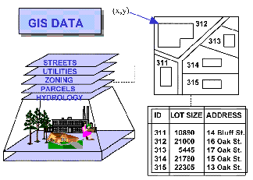
GIS for Spatial ‘Omics’ information Maps

Slide 44

Interoperability – Creating in the ‘O’ Gap
EXCELLING AT BALANCE
How do we guide OMICs in PRECISION MEDICINE and also protect PRIVACY AND SECURITY ?
How do we interoperate ACTIONABLE OMICS in CDS and QUALITY BEST PRACTICES affordably and accurately?
How do we ensure Quality Standards in the ‘O’ GAP around OMICS in accelerating Precision Medicine?

Slide 45








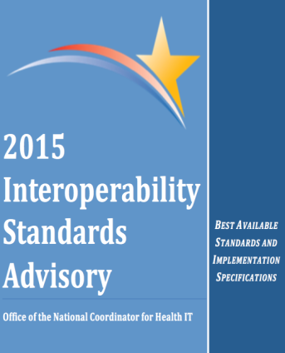









SYNERGIZING LEADERSHIP in the ‘O’ GAP

Slide 46

The Frontiers of Precision Medicine and
Genomic Interoperability Standards
Summary Points:
The ONC mission is leading the nation accelerating desired information flow, interoperability, and a personalized, learning health system.
The interoperability of omics biomarkers for targeted use in precision medicine requires that validation analytics and standards technologies ensure accurate, reproducible, assay performance.
Successful integration of validated omic-derived biomarkers into certification testing programs may aid patient diagnosis and risk stratification in the new era of precision medicine.
Our ability to interoperate, certify, and standardize omics data in clinical settings is key to the ultimate success of precision medicine.
Notes:
The ONC mission is leading the nation accelerating desired information flow, interoperability, and a personalized, learning health system.
The interoperability of omics biomarkers for targeted use in precision medicine requires that validation analytics and standards technologies ensure accurate, reproducible, assay performance.
The Jury is still out but ------ Successful integration of validated omic-derived biomarkers into certification testing programs may aid patient diagnosis and risk stratification in the new era of precision medicine.
Our ability to interoperate, certify, and standardize omics data in clinical settings is key to the ultimate success of precision medicine.

